Slide 1
Digital Portfolio
STUDENT NAME: DHINESHKUMAR M
REGISTER NO AND NMID: asbru092422k2242
DEPARTMENT: COMPUTER SCIENCE
COLLEGE: GOVERNMENT ARTS COLLEGE,UDUMALPET/ BHARATHIYAR UNIVERSITY

Slide 2
PROJECT TITLE INTERACTIVE DIGITAL PORTFOLIO USING FRONT END WEB DEVELOPMENT

Slide 3


AGENDA
Problem Statement
Project Overview
End Users
Tools and Technologies
Portfolio design and Layout
Features and Functionality
Results and Screenshots
Conclusion
Github Link
3/21/2024 Annual Review

Slide 4

PROBLEM STATEMENT 1. A normal resume feels too plain and doesn’t highlight creativity. 2. Freshers often struggle to showcase their skills and projects effectively. 3. There is a need for a modern, responsive, and easy-to-access portfolio. 4. A personal portfolio website solves this by acting as a digital identity.

Slide 5

PROJECT OVERVIEW 1. A Digital personal Portfolio website built using HTML,CSS and JavaScript. 2. This project is a personal portfolio website created to showcase my skills, projects, education, and contact details in a professional way. 3. The website is designed with a modern black-and-white theme and is fully responsive, making it accessible on both desktop and mobile devices. 4. It includes separate sections such as About Me, Skills, Projects, Resume, and Contact, with smooth navigation and clean design. A downloadable resume and LinkedIn link are also included to make it easy for recruiters or collaborators to connect. 5. Overall, the portfolio serves as my digital identity, highlighting not just my technical knowledge but also my creativity and personality.

Slide 6

WHO ARE THE END USERS? 1. Recruiters & Hiring Managers – to check your skills, resume, and projects for job opportunities. 2. College/Faculty Members – to evaluate your work for academic purposes or project submissions. 3. Peers & Collaborators – other developers or students who might want to collaborate with you. 4. General Visitors – anyone who wants to know more about you and your professional journey.

Slide 7

TOOLS AND TECHNIQUES · HTML5 – for structuring the web pages. · CSS3 – for styling and creating a modern black-and-white theme with responsive design. · JavaScript – for interactivity like navigation and button hover effects. · VS Code – as the code editor for development.

Slide 8
POTFOLIO DESIGN AND LAYOUT
Header & Navigation – Name, title, photo, and navigation bar with clean buttons.
Hero Section – A short introduction highlighting passion and goals.
Content Section – Skills shown in button-style boxes, projects in simple descriptive cards.
Resume,Contact & Footer – Downloadable resume, phone, email, and LinkedIn link and copyright footer.
8

Slide 9
FEATURES AND FUNCTIONALITY 1. Responsive Design – Works on both mobile and desktop. 2. Navigation Bar – Easy movement between sections. 3. Skills & Projects Display – Showcases your technical skills and project details clearly. 4. Resume Download – Provides a button to download your resume in PDF format. 5. Contact Information – Email, phone, and LinkedIn for easy communication. 6. Footer – Professional copyright note.

Slide 10
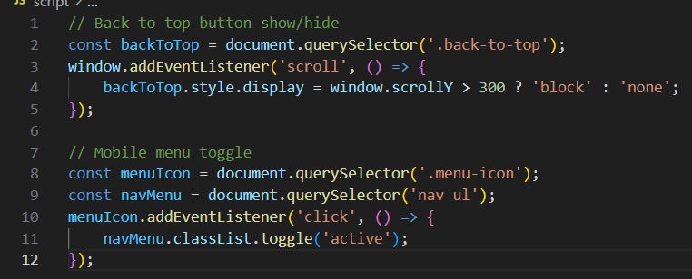
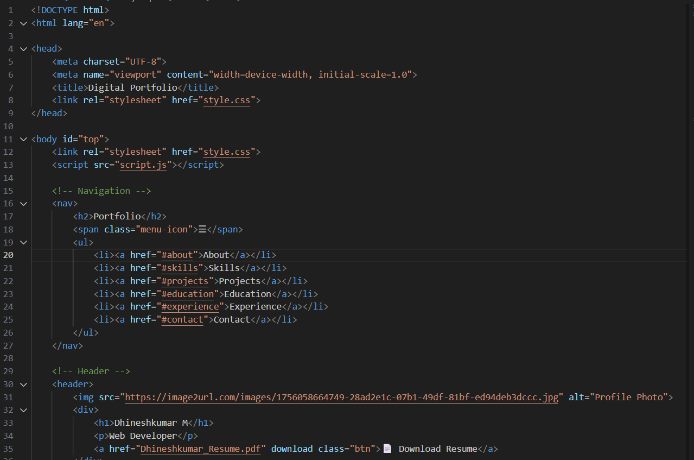
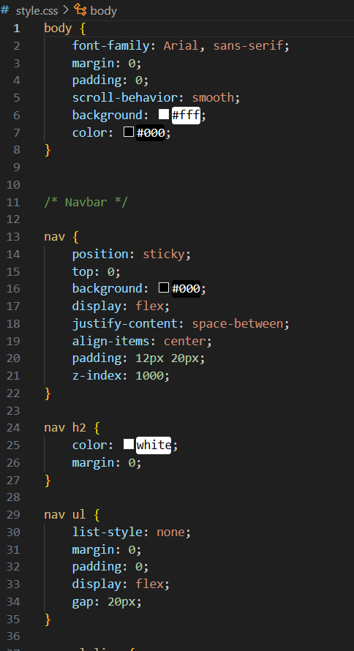
RESULTS AND SCREENSHOTS
10

Slide 11
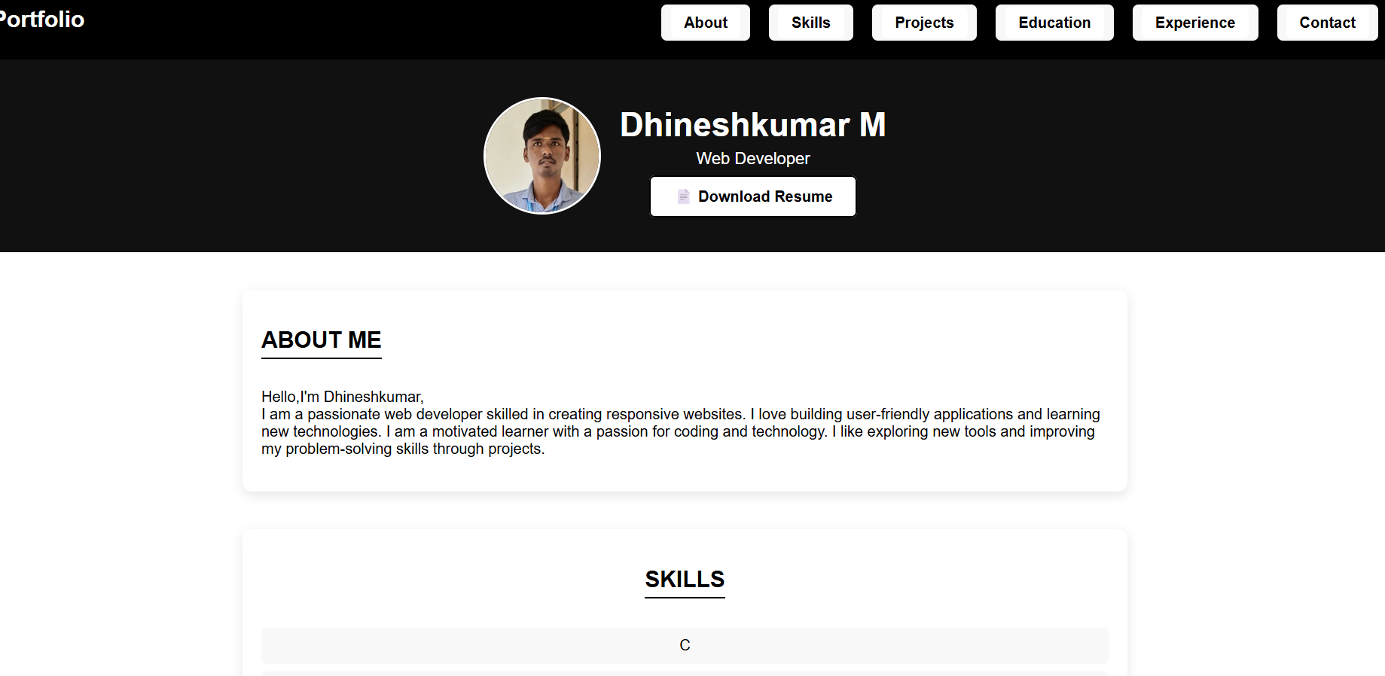
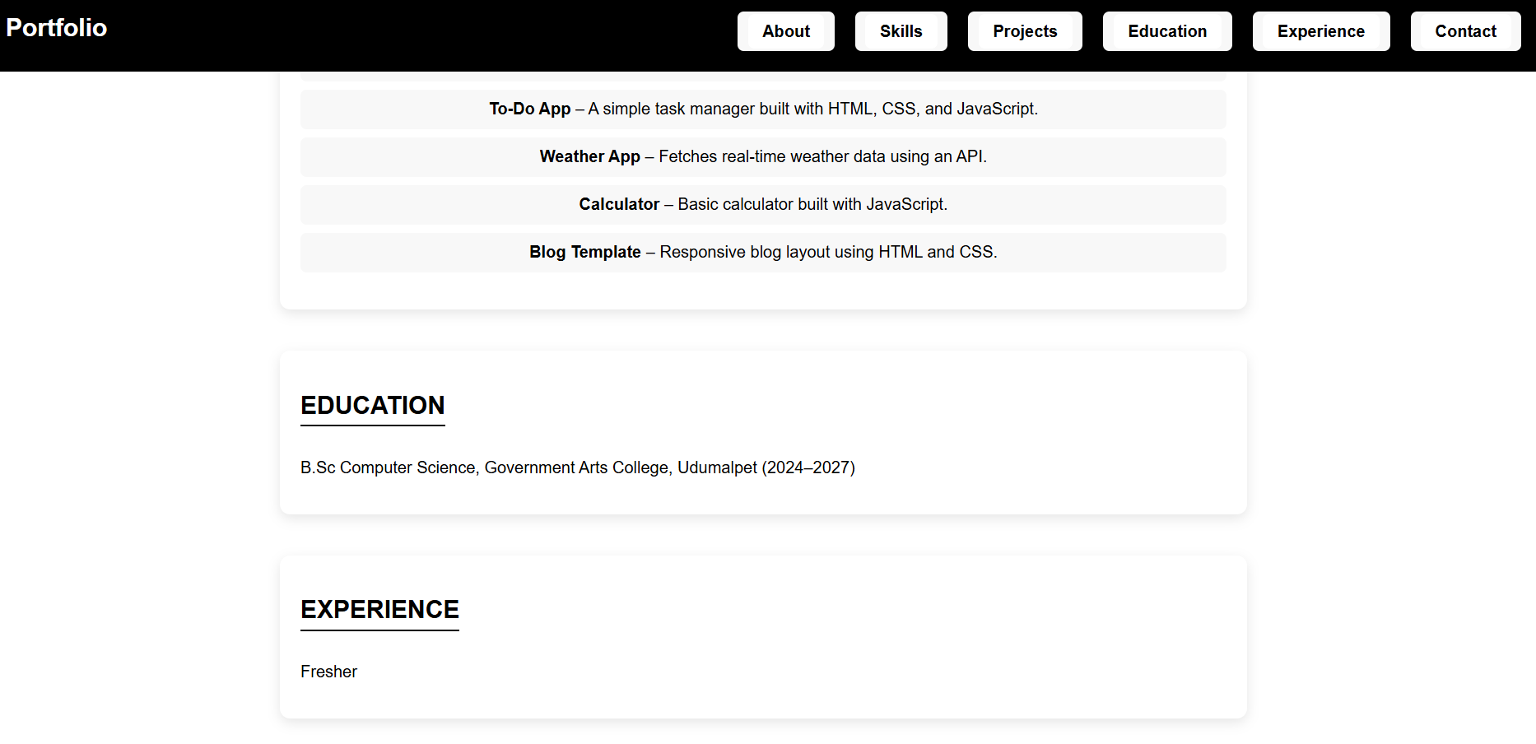
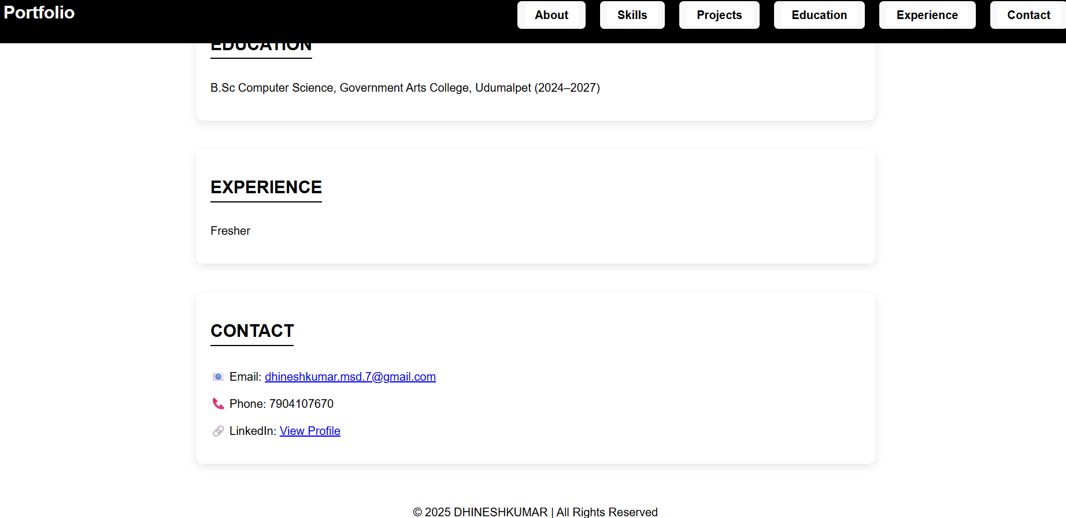
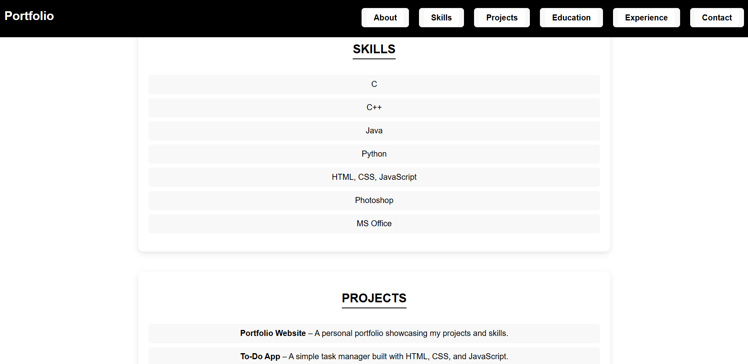

Slide 12
CONCLUSION 1. This portfolio website effectively showcases my personal and professional details in a clean and modern layout. 2. Its responsive design and interactive features enhances user experience. 3. It highlights my skills, projects, education, and contact information while providing a downloadable resume. 4. The responsive design ensures accessibility on both desktop and mobile devices, making it a useful tool for presenting myself to recruiters, employers, and collaborators.
12

